Slide 1
Practice 8 - RTA for RM on Multiprocessors

Slide 2
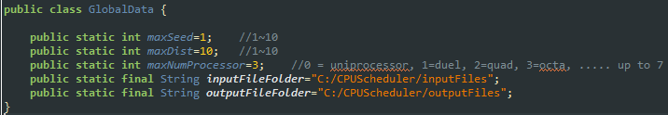
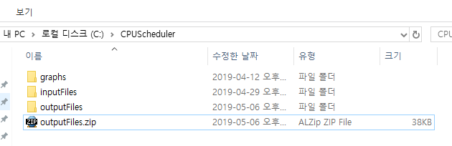
You should complete implementing RTA for RM on Multiprocessors
in CPUScheduler V3_3
Follow the following steps
There should be file folders for input & output files in your PC; modify GlobalData.java and create the corresponding folders
Download outputFiles.zip from E-learning site, and unzip the file to your outputfile folder

Slide 3


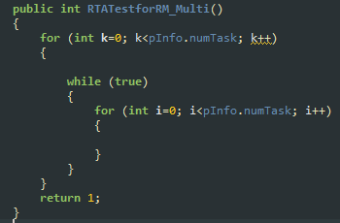
Create input files; run _Gen_Set.java
Complete “RTATestforRM_Multi”; modify Analysis.java

Slide 4
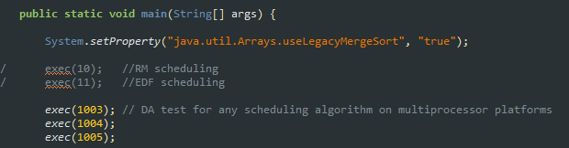
run _Exec_Set.java file; you don’t have to run for ’10’ and ‘11’

Slide 5
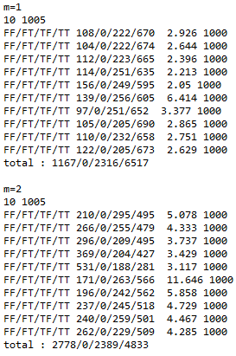
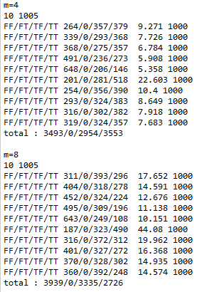
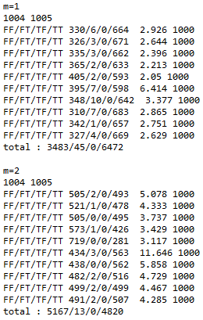
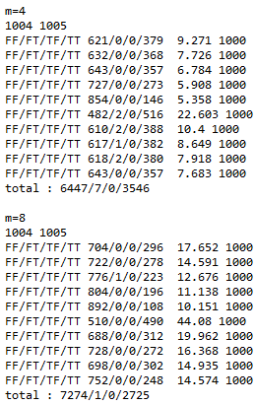
You see the following results by executing __ResultCompare.java

Slide 6
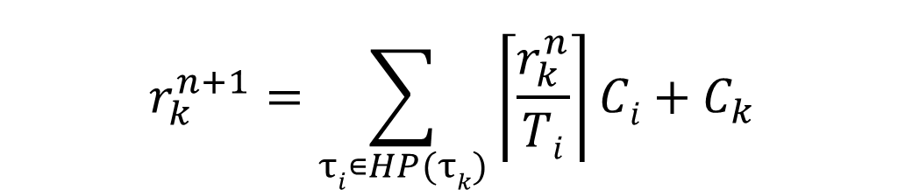

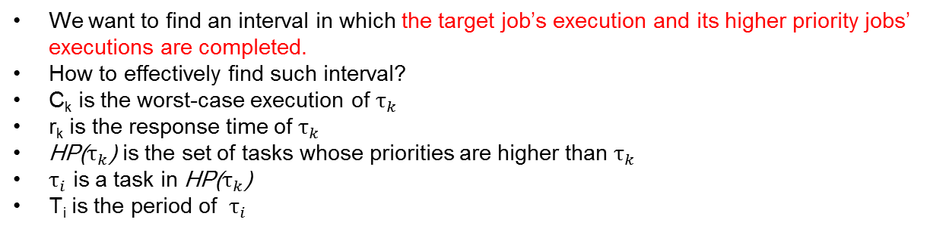
Response time analysis for RM
Worst-case interference
$$r_{k}^{n+1}=\sum_{τi∊HP(τk)}{\left\lceil \frac{r_{k}^{n}}{Ti}\right\rceil Ci+C_{k}}$$
response time of a job under analysis
WCET
HP($τ_{k}$) : a set of higher-priority tasks
We want to find an interval in which the target job’s execution and its higher priority jobs’ executions are completed.
How to effectively find such interval?
C_{k} is the worst-case execution of $τ_{k}$
r_{k} is the response time of $τ_{k}$
HP($τ_{k}$) is the set of tasks whose priorities are higher than $τ_{k}$
$τ_{i}$ is a task in HP($τ_{k}$)
T_{i} is the period of $τ_{i}$
τ₁
(4,1,4)
τ_{i}
τ₂
(5,2,5)
τ_{k}
τ₃
(10,3,10)

Slide 7
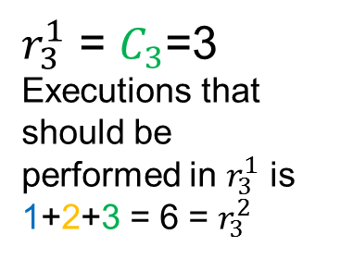
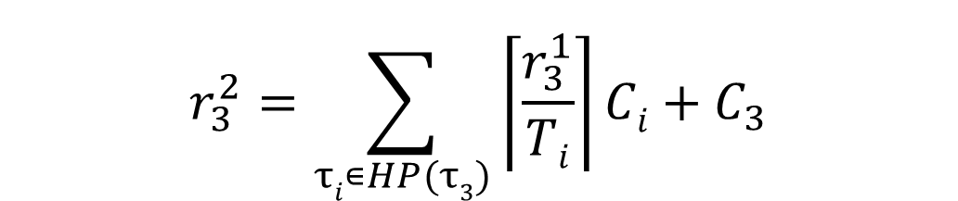

Response time analysis for RM
$$r_{3}^{2}=\sum_{τi∊HP(τ3)}{\left\lceil \frac{r_{3}^{1}}{Ti}\right\rceil Ci+C_{3}}$$
$r_{3}^{1}$ = $C_{3}$=3
Executions that should be performed in $r_{3}^{1}$ is
1+2+3 = 6 = $r_{3}^{2}$
HP($τ_{k}$) : a set of higher-priority tasks
$$r_{3}^{1}$$
T,C,D
τ₁
(4,1,4)
0
4
8
τ₂
(5,2,5)
0
5
10
τ₃
(10,3,10)
5
10
release time
response time
preemption
preemption

Slide 8

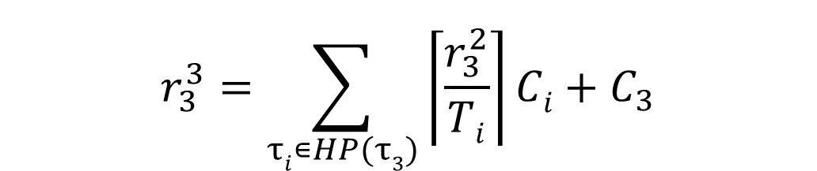
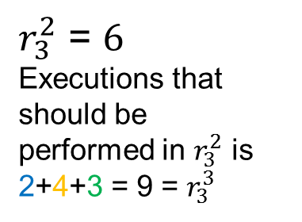
Response time analysis for RM
$$r_{3}^{3}=\sum_{τi∊HP(τ3)}{\left\lceil \frac{r_{3}^{2}}{Ti}\right\rceil Ci+C_{3}}$$
$r_{3}^{2}$ = $6$
Executions that should be performed in $r_{3}^{2}$ is
2+4+3 = 9 = $r_{3}^{3}$
HP($τ_{k}$) : a set of higher-priority tasks
$$r_{3}^{2}$$
T,C,D
τ₁
(4,1,4)
0
4
8
τ₂
(5,2,5)
0
5
10
τ₃
(10,3,10)
5
10
release time
response time
preemption
preemption

Slide 9

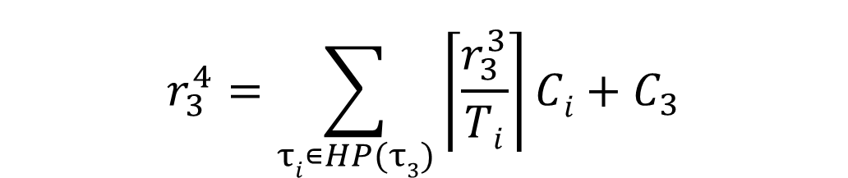
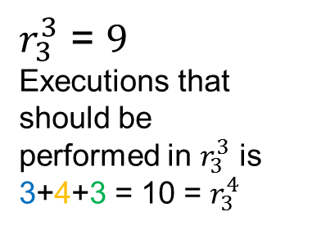
Response time analysis for RM
$$r_{3}^{4}=\sum_{τi∊HP(τ3)}{\left\lceil \frac{r_{3}^{3}}{Ti}\right\rceil Ci+C_{3}}$$
$r_{3}^{3}$ = $9$
Executions that should be performed in $r_{3}^{3}$ is
3+4+3 = 10 = $r_{3}^{4}$
HP($τ_{k}$) : a set of higher-priority tasks
$$r_{3}^{3}$$
T,C,D
τ₁
(4,1,4)
0
4
8
τ₂
(5,2,5)
0
5
10
τ₃
(10,3,10)
5
10
release time
response time
preemption
preemption

Slide 10

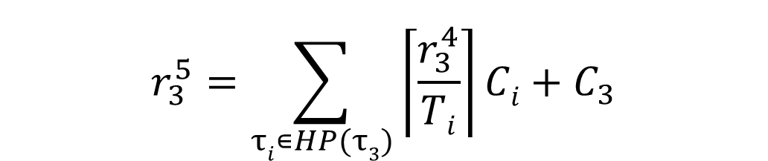

Response time analysis for RM
$$r_{3}^{5}=\sum_{τi∊HP(τ3)}{\left\lceil \frac{r_{3}^{4}}{Ti}\right\rceil Ci+C_{3}}$$
$r_{3}^{4}$ = $10$
Executions that should be performed in $r_{3}^{4}$ is
3+4+3 = 10 = $r_{3}^{5}$
HP($τ_{k}$) : a set of higher-priority tasks
$$r_{3}^{4}$$
T,C,D
τ₁
(4,1,4)
Equal:
We find the interval that we wanted
0
4
8
τ₂
(5,2,5)
0
5
10
τ₃
(10,3,10)
5
10
release time
response time
preemption
preemption

Slide 11
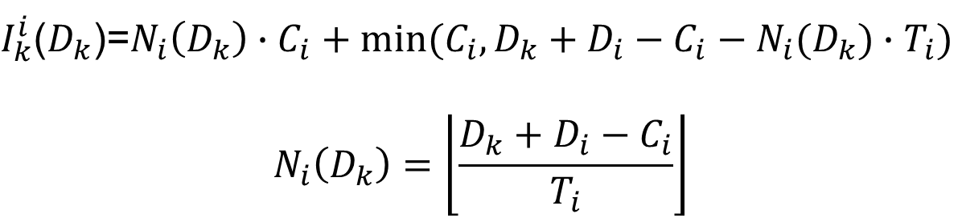
Schedulaiblity Analysis for Global Scheduling on Multiprocessor
The worst-case release pattern of τ_{i} maximizing $I_{k}^{i}\left(D_{k}\right)$
$I_{k}^{i}$($D_{k}$)=$N_{i}\left(D_{k}\right)∙C_{i}+min⁡(C_{i},D_{k}+D_{i}−C_{i}−N_{i}(D_{k})∙T_{i})$
$$N_{i}\left(D_{k}\right)=\left\lfloor \frac{D_{k}+D_{i}−C_{i}}{T_{i}}\right\rfloor$$
job release/deadline
execution
D_{k}
T_{i}
C_{i}
D_{i}

Slide 12
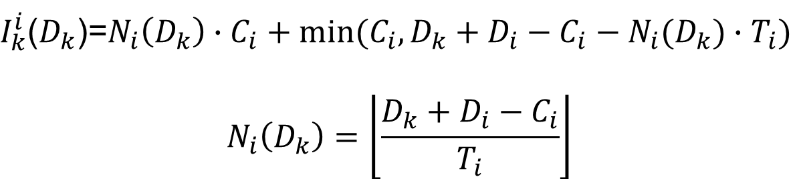
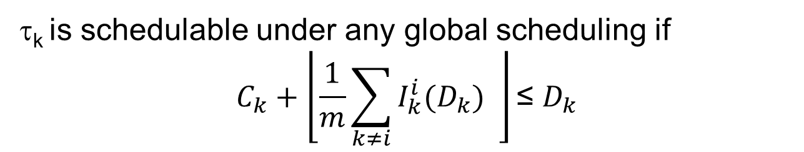
Schedulaiblity Analysis for Global Scheduling on Multiprocessor
Deadline-Based Analysis (DA analysis) – base idea
τ_{k} is schedulable under any global scheduling if
$$C_{k}+\left\lfloor \frac{1}{m}\sum_{k≠i}{I_{k}^{i}(D_{k})} \right\rfloor \text{≤} D_{k}$$
$I_{k}^{i}$($D_{k}$)=$N_{i}\left(D_{k}\right)∙C_{i}+min⁡(C_{i},D_{k}+D_{i}−C_{i}−N_{i}(D_{k})∙T_{i})$
$$N_{i}\left(D_{k}\right)=\left\lfloor \frac{D_{k}+D_{i}−C_{i}}{T_{i}}\right\rfloor$$
You should implement this in Analysis.java

Slide 13
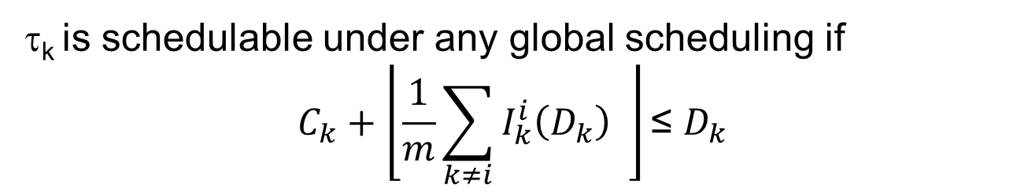



Pessimistic estimation of DA analysis
τ_{k} is schedulable under any global scheduling if
$$C_{k}+\left\lfloor \frac{1}{m}\sum_{k≠i}{I_{k}^{i}\left(D_{k}\right)} \right\rfloor \text{≤} D_{k}$$
$I_{k}^{i}(D_{k})$= amount of execution of τ_{i} performed in D_{k}
$$\text{I}\text{k}\text{(}\text{Dk}\text{)=5}$$
20
m=3
20
5
10
In reality
$\text{D}\text{k}$=20
In analysis
$$10+15 \text{>} 20$$

Slide 14
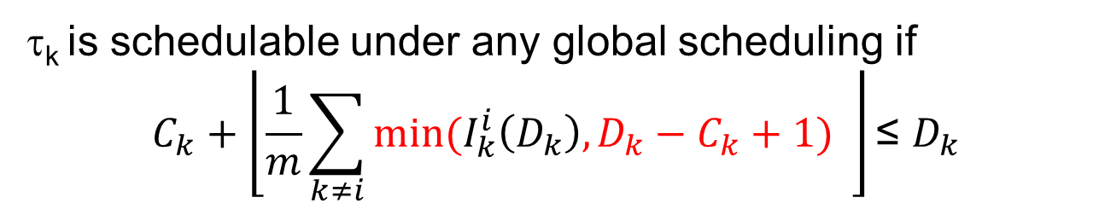



“Improved” deadline-Based Analysis (DA analysis)
τ_{k} is schedulable under any global scheduling if
$$C_{k}+\left\lfloor \frac{1}{m}\sum_{k≠i}{min⁡(I_{k}^{i}\left(D_{k}\right),D_{k}−C_{k}+1)} \right\rfloor \text{≤} D_{k}$$
$I_{k}^{i}(D_{k})$= amount of execution of τ_{i} performed in D_{k}
$\text{D}\text{k}\text{−}\text{Ck}$+1=11
20
m=3
20
5
10
$\text{D}\text{k}$=20
We focus on $"\text{D}\text{k}\text{−}\text{Ck}$+1” rather than $\text{D}\text{k}$

Slide 15
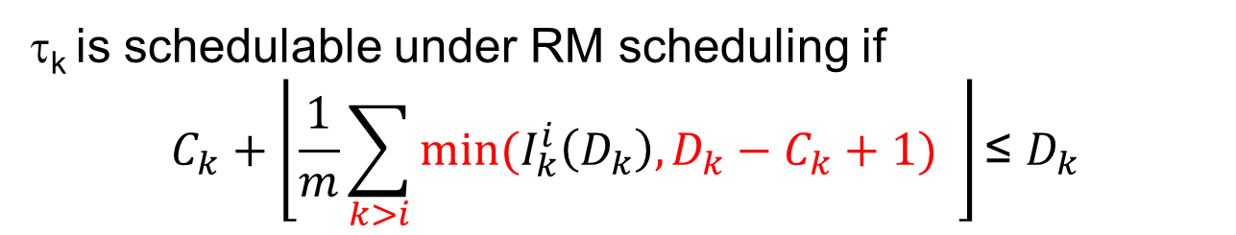
“Improved” deadline-Based Analysis (DA analysis) for RM
τ_{k} is schedulable under RM scheduling if
$$C_{k}+\left\lfloor \frac{1}{m}\sum_{k>i}{min⁡(I_{k}^{i}\left(D_{k}\right),D_{k}−C_{k}+1)} \right\rfloor \text{≤} D_{k}$$
$I_{k}^{i}(D_{k})$= amount of execution of τ_{i} performed in D_{k}
$\text{D}\text{k}\text{−}\text{Ck}$+1=11
20
m=3
20
5
10
$\text{D}\text{k}$=20
We ignore execution of lower priority jobs

Slide 16

“Improved” deadline-Based Analysis (DA analysis) for RM
τ_{k} is schedulable under RM scheduling if
$$C_{k}+\left\lfloor \frac{1}{m}\sum_{k>i}{min⁡(I_{k}^{i}\left(D_{k}\right),D_{k}−C_{k}+1)} \right\rfloor \text{≤} D_{k}$$
$I_{k}^{i}$($D_{k}$)=$N_{i}\left(D_{k}\right)∙C_{i}+min⁡(C_{i},D_{k}+D_{i}−C_{i}−N_{i}(D_{k})∙T_{i})$
$$N_{i}\left(D_{k}\right)=\left\lfloor \frac{D_{k}+D_{i}−C_{i}}{T_{i}}\right\rfloor$$

Slide 17
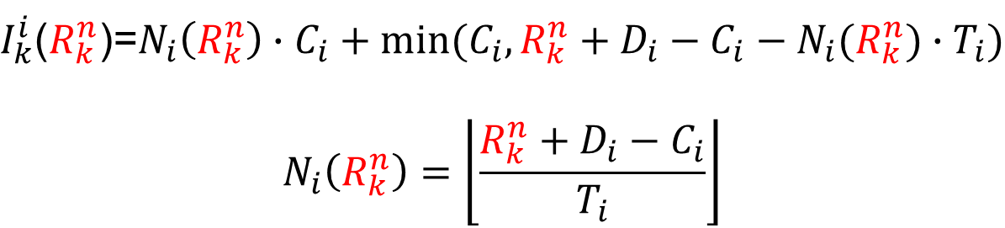
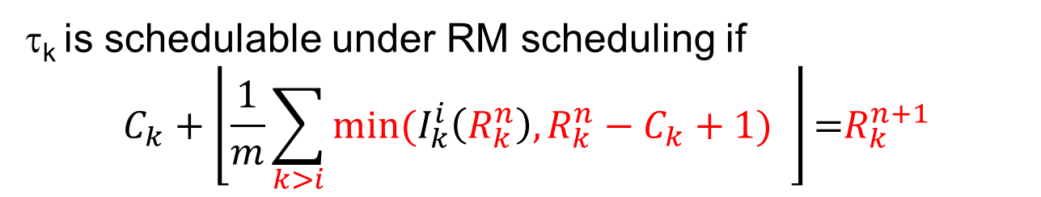
RTA for RM
τ_{k} is schedulable under RM scheduling if
$$C_{k}+\left\lfloor \frac{1}{m}\sum_{k>i}{min⁡(I_{k}^{i}\left(R_{k}^{n}\right),R_{k}^{n}−C_{k}+1)} \right\rfloor \text{=}R_{k}^{n+1}$$
$I_{k}^{i}$($R_{k}^{n}$)=$N_{i}\left(R_{k}^{n}\right)∙C_{i}+min⁡(C_{i},R_{k}^{n}+D_{i}−C_{i}−N_{i}(R_{k}^{n})∙T_{i})$
$$N_{i}\left(R_{k}^{n}\right)=\left\lfloor \frac{R_{k}^{n}+D_{i}−C_{i}}{T_{i}}\right\rfloor$$

Slide 18

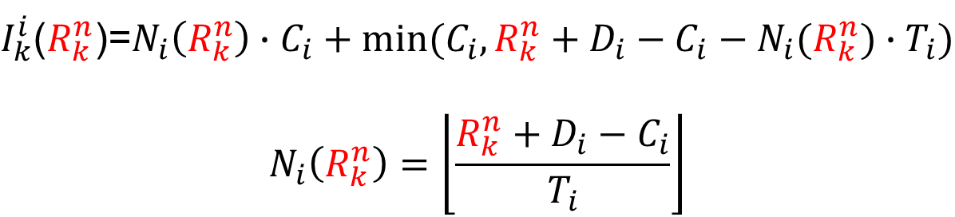
Schedulaiblity Analysis for Global Scheduling on Multiprocessor
The worst-case release pattern of τ_{i} maximizing $I_{k}^{i}\left(R_{k}^{n}\right)$
$I_{k}^{i}$($R_{k}^{n}$)=$N_{i}\left(R_{k}^{n}\right)∙C_{i}+min⁡(C_{i},R_{k}^{n}+D_{i}−C_{i}−N_{i}(R_{k}^{n})∙T_{i})$
$$N_{i}\left(R_{k}^{n}\right)=\left\lfloor \frac{R_{k}^{n}+D_{i}−C_{i}}{T_{i}}\right\rfloor$$
job release/deadline
execution
$$R_{k}^{n}$$
T_{i}
C_{i}
D_{i}

